Slide 1
Crowdfunding Do’s and Don’ts
Graham Rogers
Student Attorney
BU Law Entrepreneurship & IP Clinic
February 26, 2016

Slide 2
What is Crowdfunding?
“the practice of soliciting financial contributions from a large number of people, especially from the online community.” – Merriam Webster

Slide 3
Types of Crowdfunding
Donation-based
Equity-based
Debt-based

Slide 4
Donation-Based Crowdfunding

Slide 5
Steps to Take
Step 1: Clear Your IP
(a) Google!
(b) Check other crowdfunding sites
(c) Check for other patents and trademarks
Patents: http://www.uspto.gov/patents-application-process/search-patents
Trademarks (TESS Search): http://www.uspto.gov/trademarks-application-process/search-trademark-database

Slide 6
Steps to Take
Step 2: Protect Your IP If Necessary
(a) Figure out what kind of IP you have (if any)
Name?
Logo?
Product design?
Original work of authorship?
Secret process?
(b) Protect your IP
File a provisional patent application?
File trademark or copyright applications
Don’t reveal secrets

Slide 7
Steps to Take
Step 3: Read the Rules and the Terms of Use
Kickstarter
Rules: https://www.kickstarter.com/rules
Terms: https://www.kickstarter.com/terms-of-use?ref=footer
Indiegogo
How It Works: https://www.indiegogo.com/how-it-works
Terms: https://www.indiegogo.com/about/terms
GoFundMe
How It Works: https://www.gofundme.com/tour/
Terms: https://www.gofundme.com/terms

Slide 8
Steps to Take
Step 4: Consider Forming a Legal Entity
Can help shield your personal assets from creditors or litigants
Must be sure to follow corporate formalities

Slide 9
Steps to Take
Step 5: Fulfill Your Promises or Offer Refunds
Exact steps will depend on the requirements of the website you use
Should factor the cost of rewards into your total fundraising amount
Should keep donors updated, especially if delays occur
If you are unable to complete your project or deliver your rewards, you might be responsible for working out an arrangement with your donors

Slide 10
Steps to Take
Step 6: Account for Your Donations Properly
Proceeds of a crowdfunding campaign might be considered income, so you might have to pay taxes on them
Remember to account for this when setting your donation goal
Keep good records of the funds raised and how they were spent
It may be helpful to engage an accountant or tax professional to help with this

Slide 11
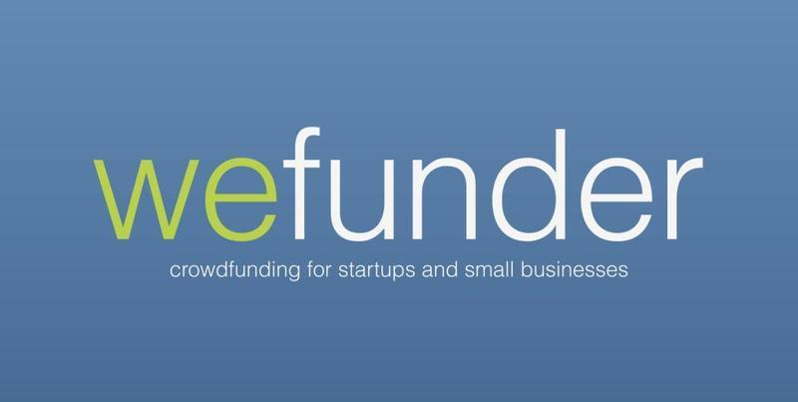
Equity-Based Crowdfunding

Slide 12
Overview of JOBS Act
Passed in 2012
Final regulations promulgated by SEC in 2015
Allows startups to sell up to $1,000,000 of equity securities in a 12-month period through a registered broker or funding portal
Some issuers are barred
There are limits on the amount of securities individual investors can buy

Slide 13
Requirements for Issuers
Disclosure requirements
Ongoing reporting obligations
Advertising Restrictions

Slide 14
Crowdfunding Alternatives
Friends and family
Small business loan
Credit cards
Personal Savings

